Slide 1

JS history & runtime

Slide 2
Agenda
History and Evolution
JS in browser
JS in node

Slide 3

Part -1
History and Evolution

Slide 4
History of java script
Created in 1995 by Brendan Eich.
Java script was developed as part of netscape navigator web browser.
This evolved to Spider Monkey, JS engine used in Firefox.
Google v8, first JS engine which supports just in time compilation.

Slide 5
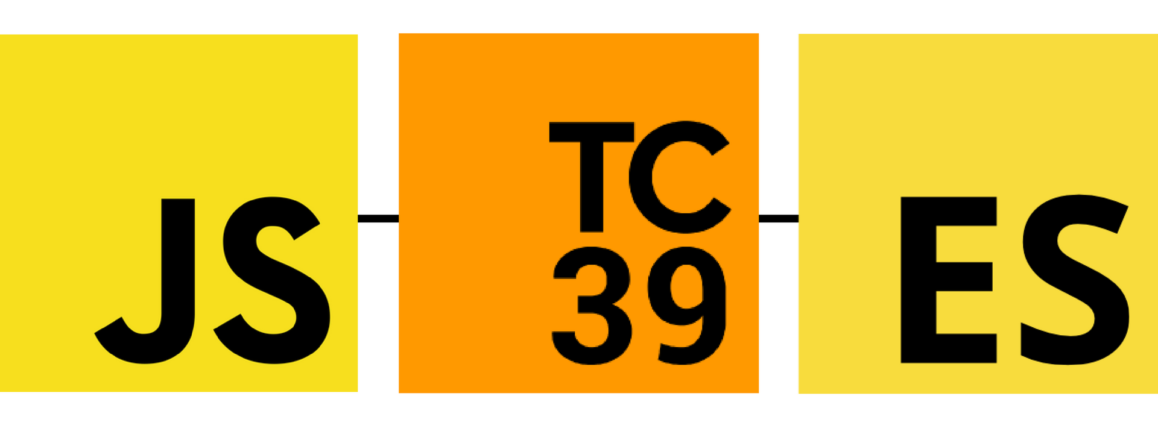

Standardizing Java Script

Slide 6
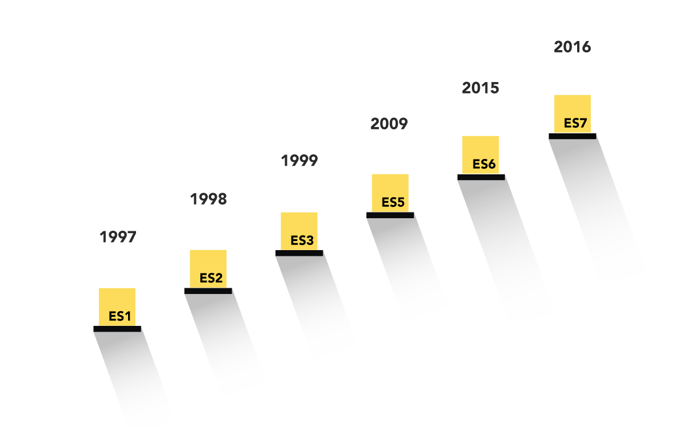
Evolution of ecma script

Slide 7


JAVASCRIPT runtime Environment

Slide 8

Part -2

Slide 9
Internals of browser
Rendering engine (WebKit)
HTML parser
CSS parser
Event loop
.
.
.
Web APIs
DOM
Console
Fetch
.
.
.
Js Runtime

Slide 10
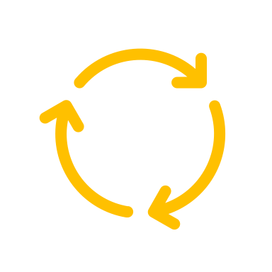
JS execution in browser
Web API container
V8 JS Engine
Heap
Stack
Event loop
Call back queue

Slide 11
Asynchronous execution
console.log(‘first line’);
setTimeout(() => {
console.log(‘async’);
}, 5000);
console.log(‘last line’);
Execution stack
CONSOLE:
first line
last line
async
Web API container
setTimeout
Console ‘first line’
setTimeout
Console ‘last line’
Console ‘async’
Call back queue
Global execution context
() => console.log(‘async’)

Slide 12
Notes
Web APIs container: The Web API calls that were sent to the Web API container from the Stack, like event listeners, HTTP/AJAX requests etc. When the function is completed a callback function is sent to the callback queue.
Callback queue: The Callback Queue will store all the callback functions in the order in which they were added. It will ‘wait’ until the Stack is completely empty. When the Stack is empty it will send the callback function at the beginning of the queue to the Stack. When the Stack is clear again, it will send over its next callback function.
Event loop: Event loop jobs is to constantly look at stack and queue. When it finds that the stack is empty it will notify the queue to send its next callback function to stack for execution. Note: The Queue and the Stack might be empty for a period of time, but the event loop never stops checking both.

Slide 13

Part -3

Slide 14
Features of NODE js
Asynchronous
Event driven
Non – blocking IO
Java Script run time

Slide 15
BLOCKING Single Threaded and Synchronous
Execution stack
function c () {
sync job(cb, 5000);
}
function b () {
c();
}
function a () {
b()
}
a();
Sync job execution context
c execution context
b execution context
a execution context
Global execution context

Slide 16
JS execution in NODE
C++ API
V8 JS Engine
Heap
Stack
Event loop
Call back queue

Slide 17
Synchronous to asynchronous
process.nextTick:
Process next tick is called as deferred callback, put the callback on top of the event queue.
Process nextTick is mostly used in API design, where we need to make some sync code to work as async.
setTimeout/setImmidiate:
Only difference is that the call back are place at end of the queue.

Slide 18
Events
events are triggering points which a system can understand.
Two type of events
System events: created by C++ side of node
Custom events: created by java script side of node

Slide 19
Event | EVENT-Emitter |EVENT-LISTENER
Event:
Named action
Event Emitter:
Event emitter are function provided by Event Object.
“.emit” - this function emits/triggers a named event.
Event Listener:
Event Listener are java script function, attached with an event.

Slide 20
Implementing events
3
Register event listener
eventObj1.on(‘morning’, wishGoodMorning);
eventObj1.on(‘morning’, reminderForBrkFast);
eventObj1.on(‘afternoon’, wishGoodAfternoon);
eventObj1.on(‘afternoon’, reminderForLunch);
2
Define event listener
function wishGoodMorning () {
c.log(‘good morning’);
}
function reminderForBrkFast () {
c.log(‘time for brk fast’);
}
function wishGoodAfternoon () {
c.log(‘good afternoon’);
}
function reminderForLunch () {
c.log(‘time for lunch’);
}
1
Define event object
const EventEmitter = require('events’);
const eventObj1 = new EventEmitter();
4
Emit actions
eventObj1.emit(‘morning’);
eventObj1.emit(‘afternoon’);

Slide 21
How event works?
An Event Emitter object, emits a named event, which invokes event Listener registered to the named event.
”.on”
is a function of events module
This function registers multiple event listener to a event.
All the function (event listener) registered to the events are executed in order they are registered.
Return value of event listener are ignored.
”THIS” of each event listener points to event object.
By default maximum event listener is 10.Change it using “emitter.setMaxListeners(n)”
Error event: In case of error, if a “error” named event is not defined, the node process stops immediately. Its better to define a “error” event.

Slide 22
References: Online: JS conference EU : https://www.youtube.com/watch?v=8aGhZQkoFbQ&t=702s ECMA international: https://www.ecma-international.org/ MDN docs: https://developer.mozilla.org/en-US/docs/Web/JavaScript/A_re-introduction_to_JavaScript Web API: https://developer.mozilla.org/en-US/docs/Web/API
THANK YOU Q & A

